Slide 1

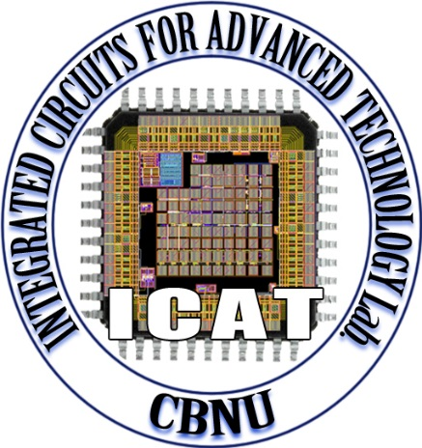
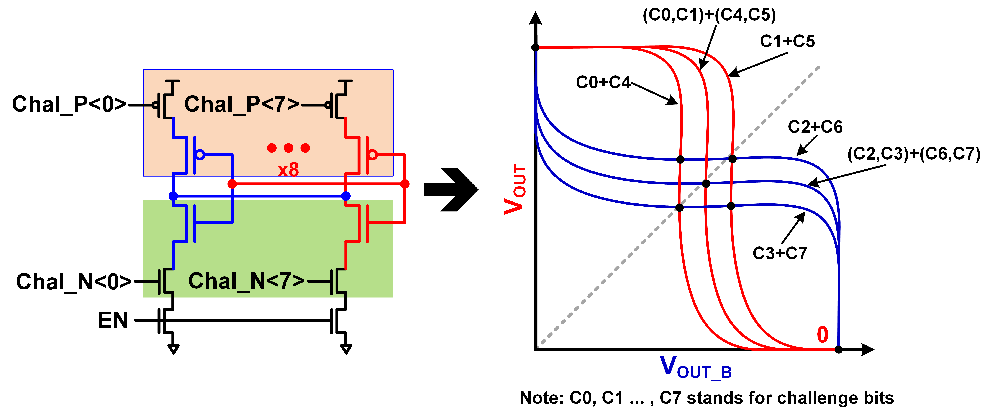
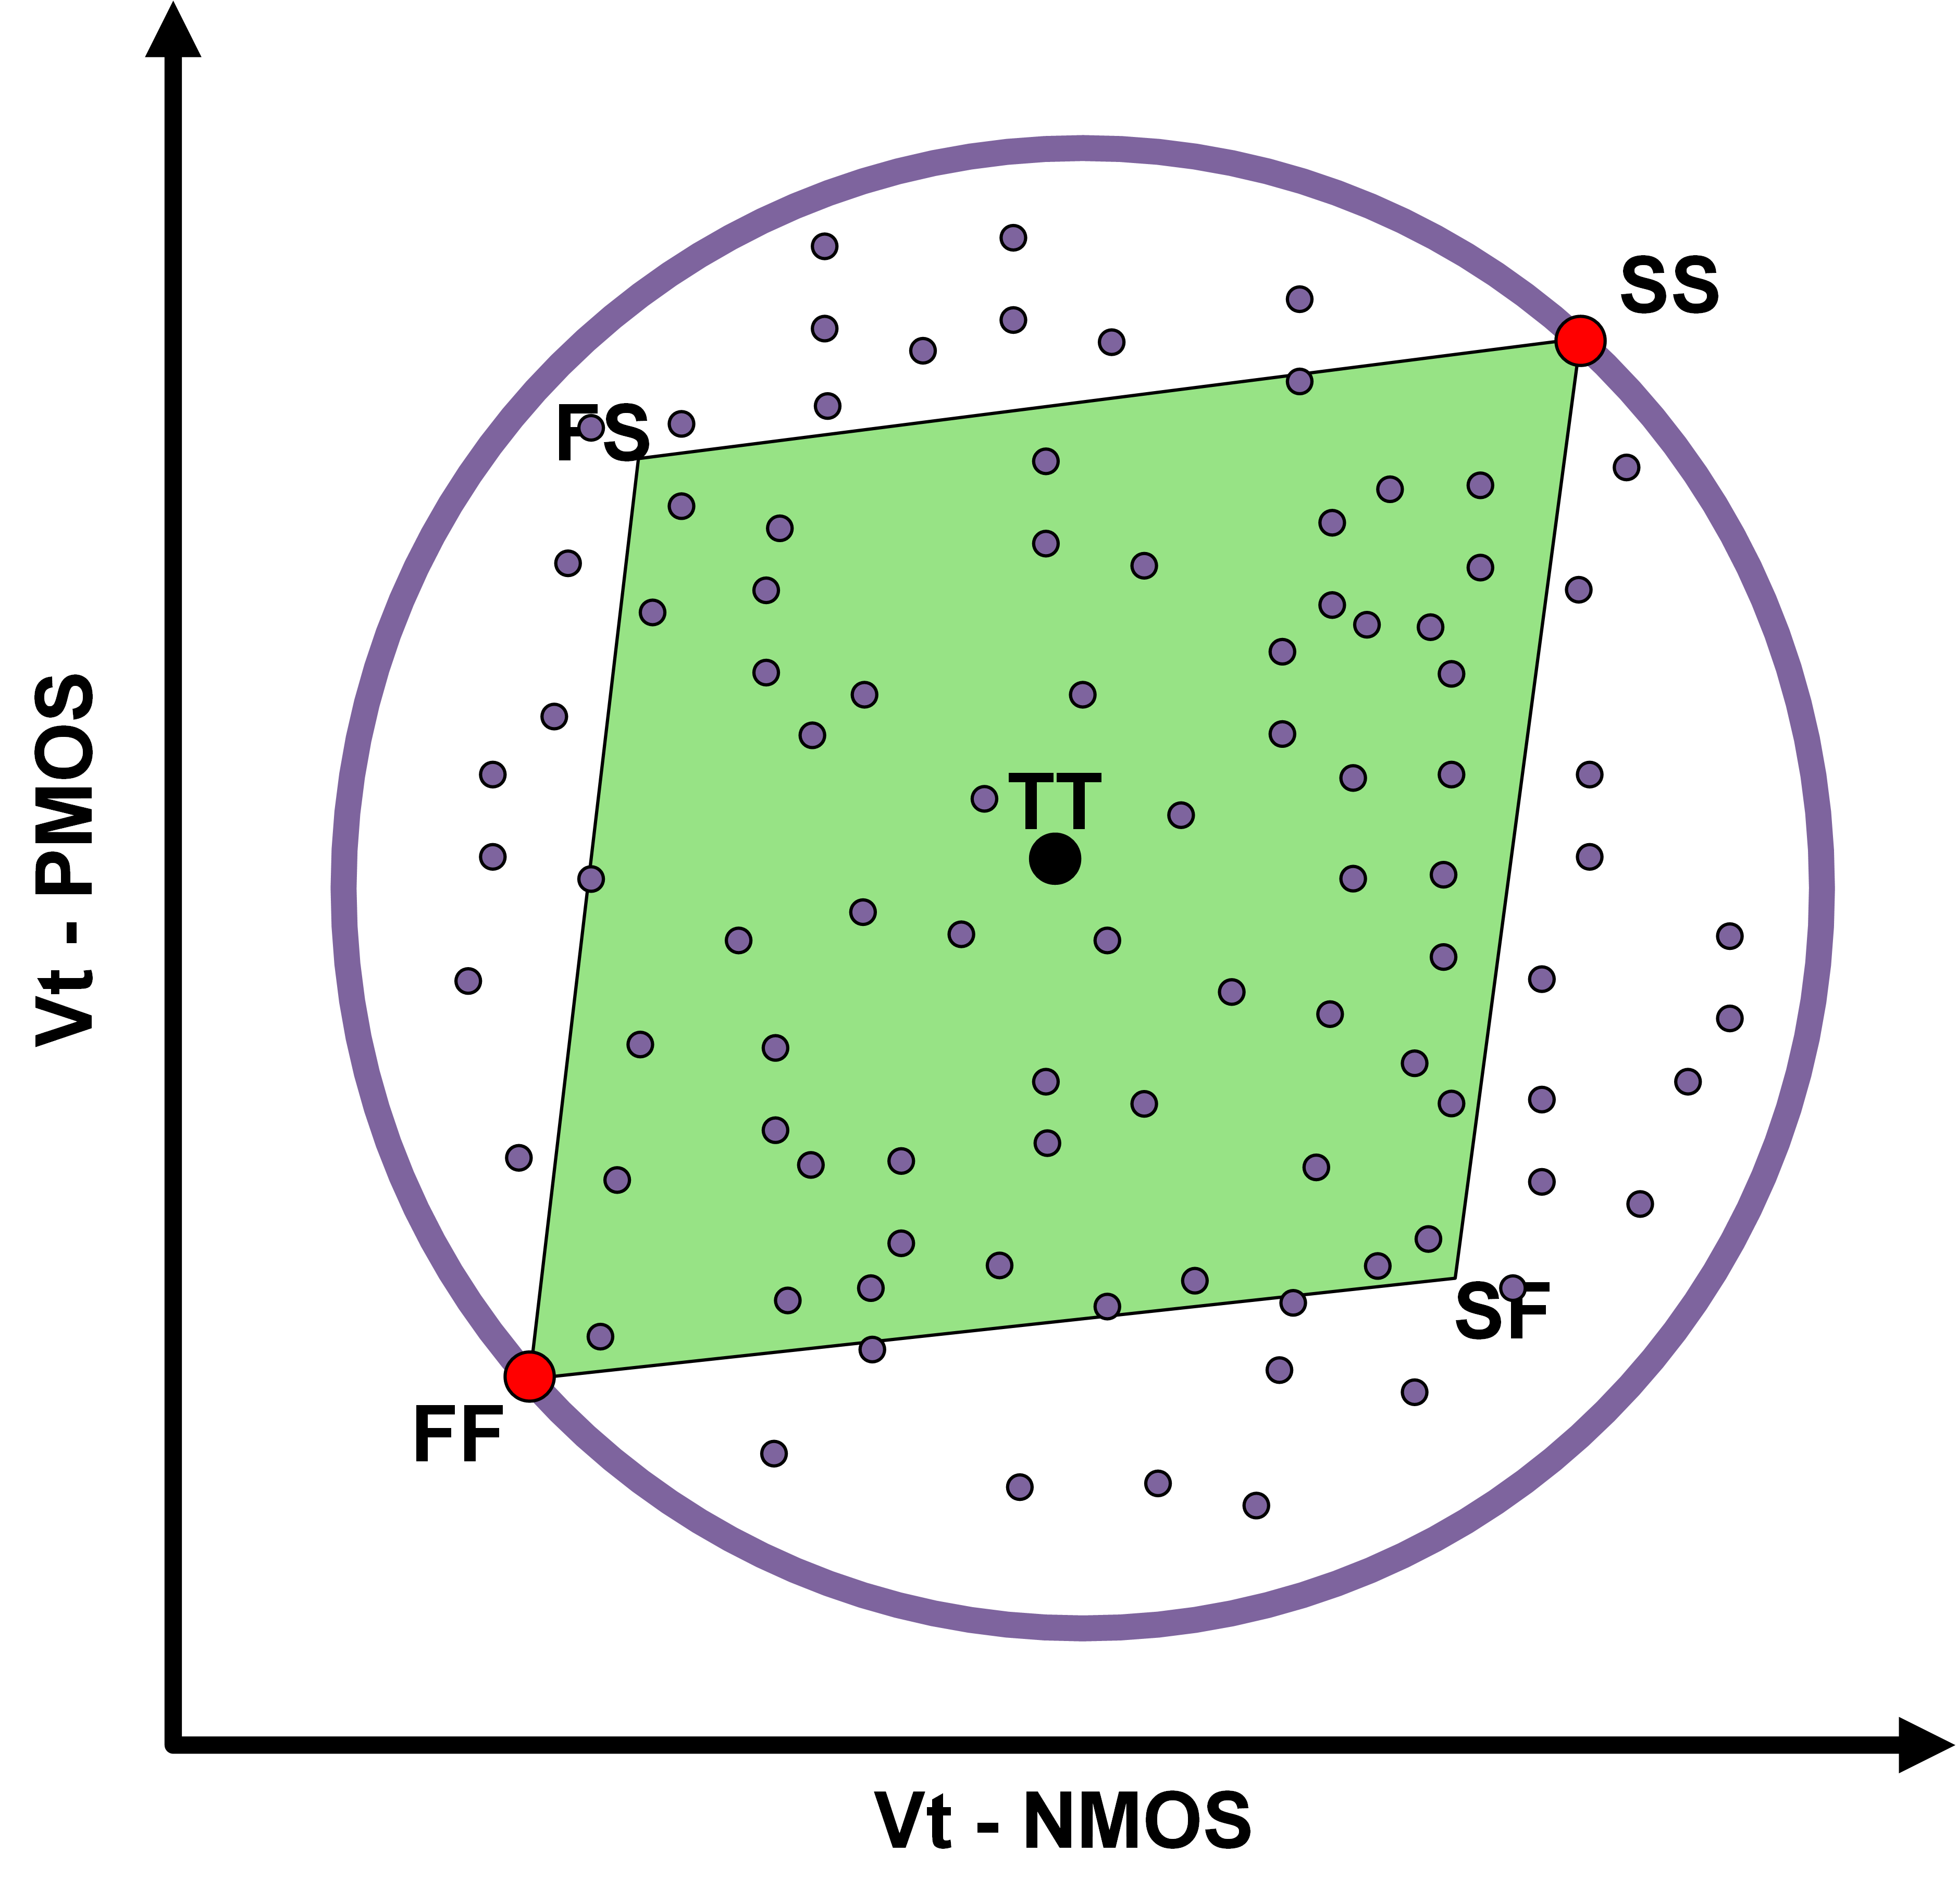
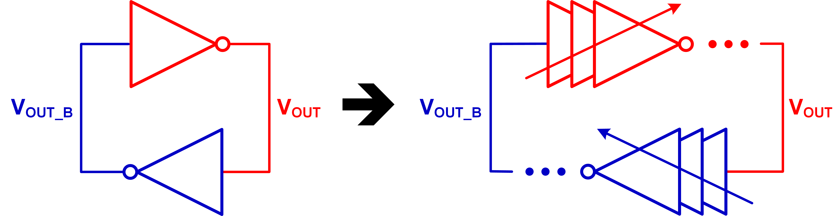
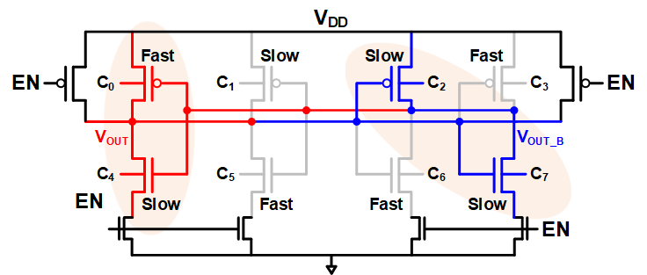
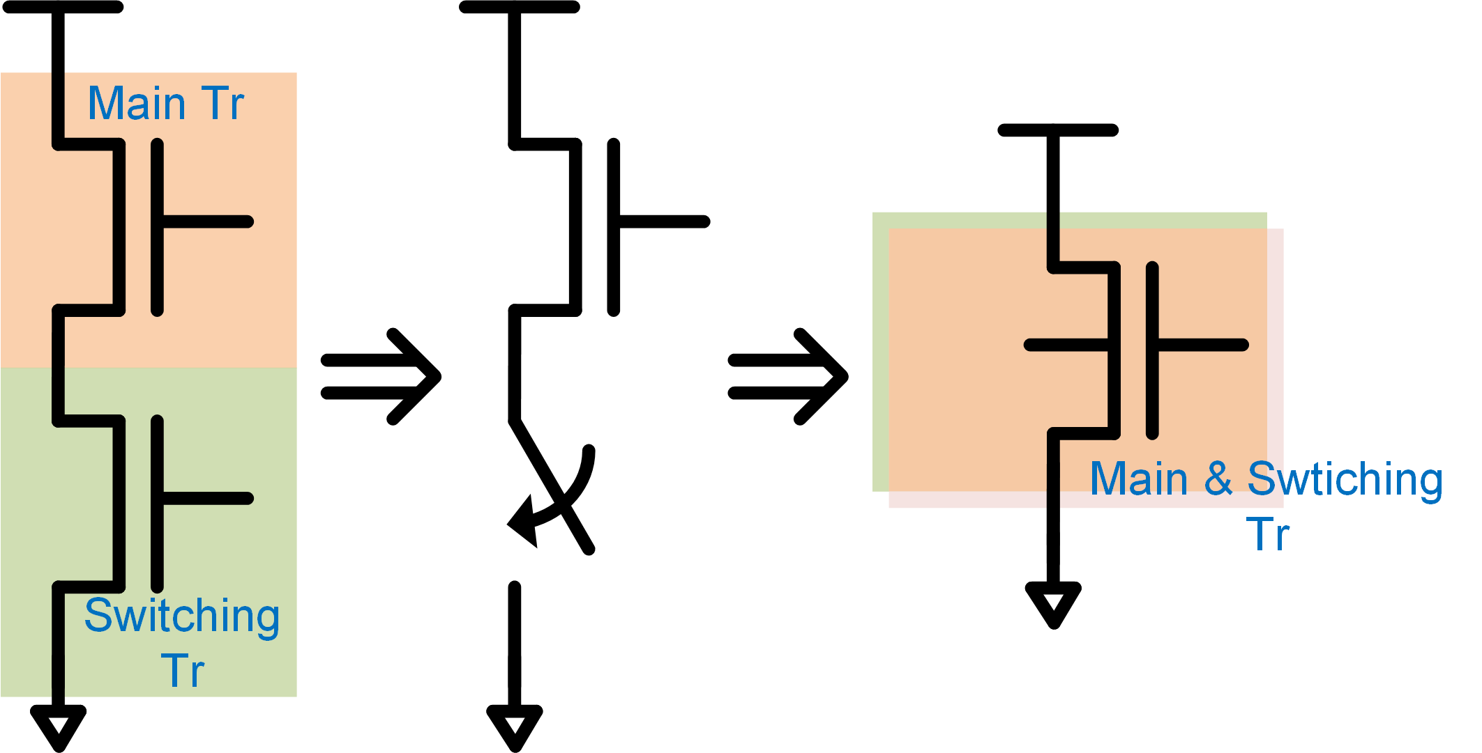
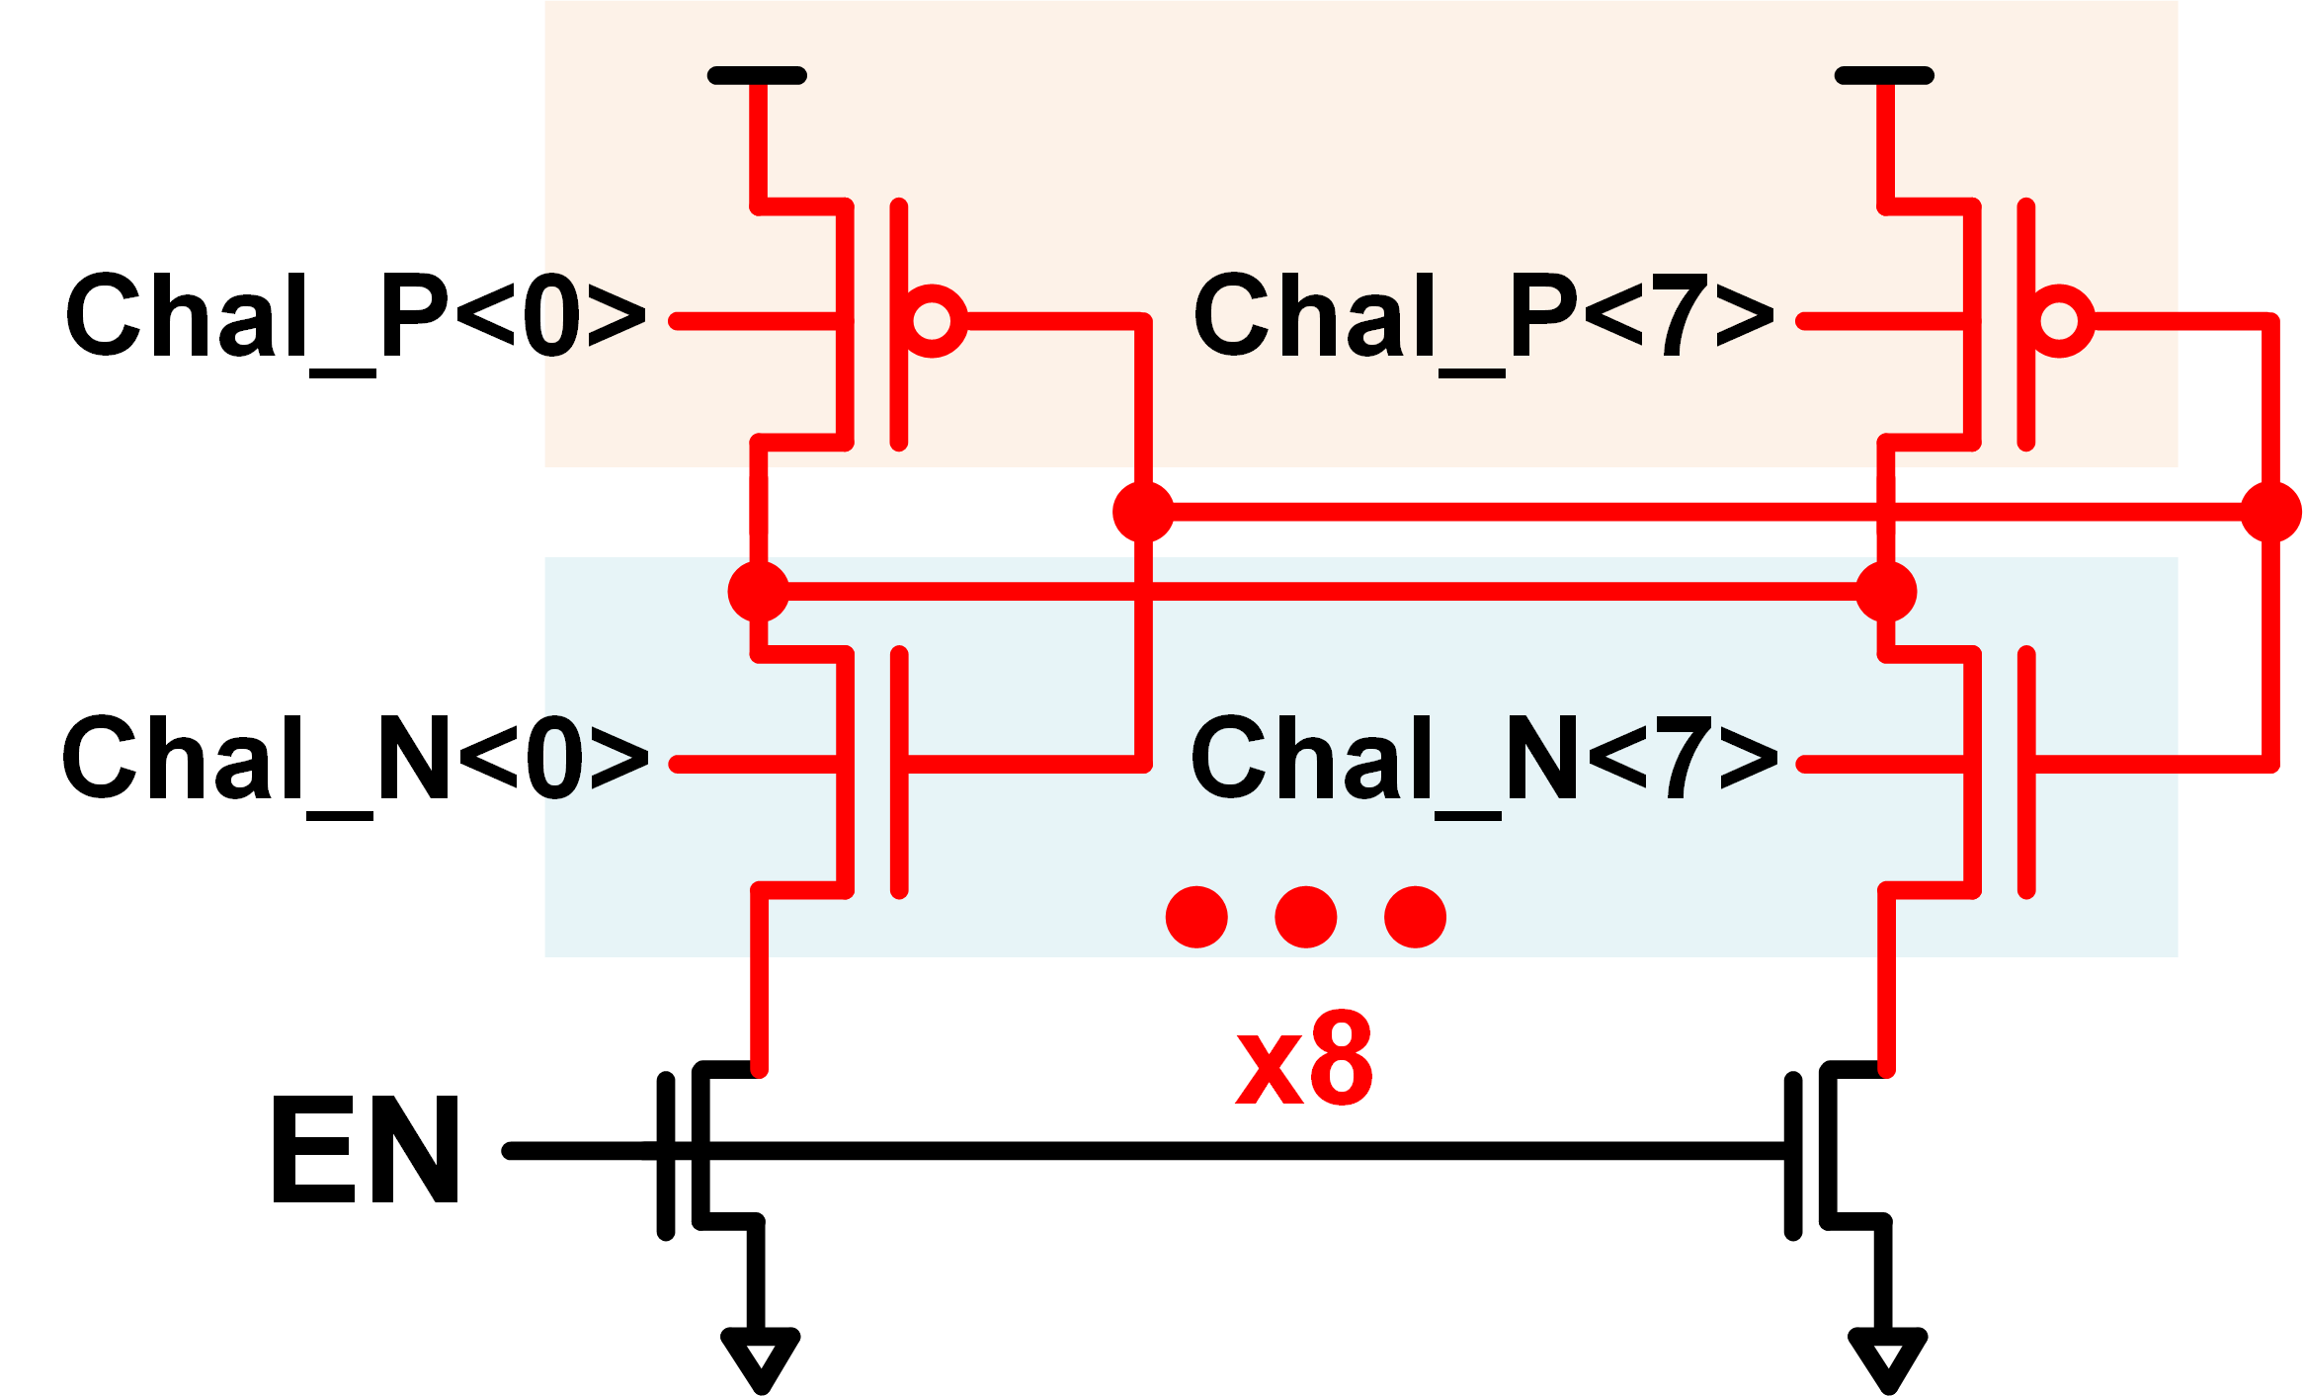
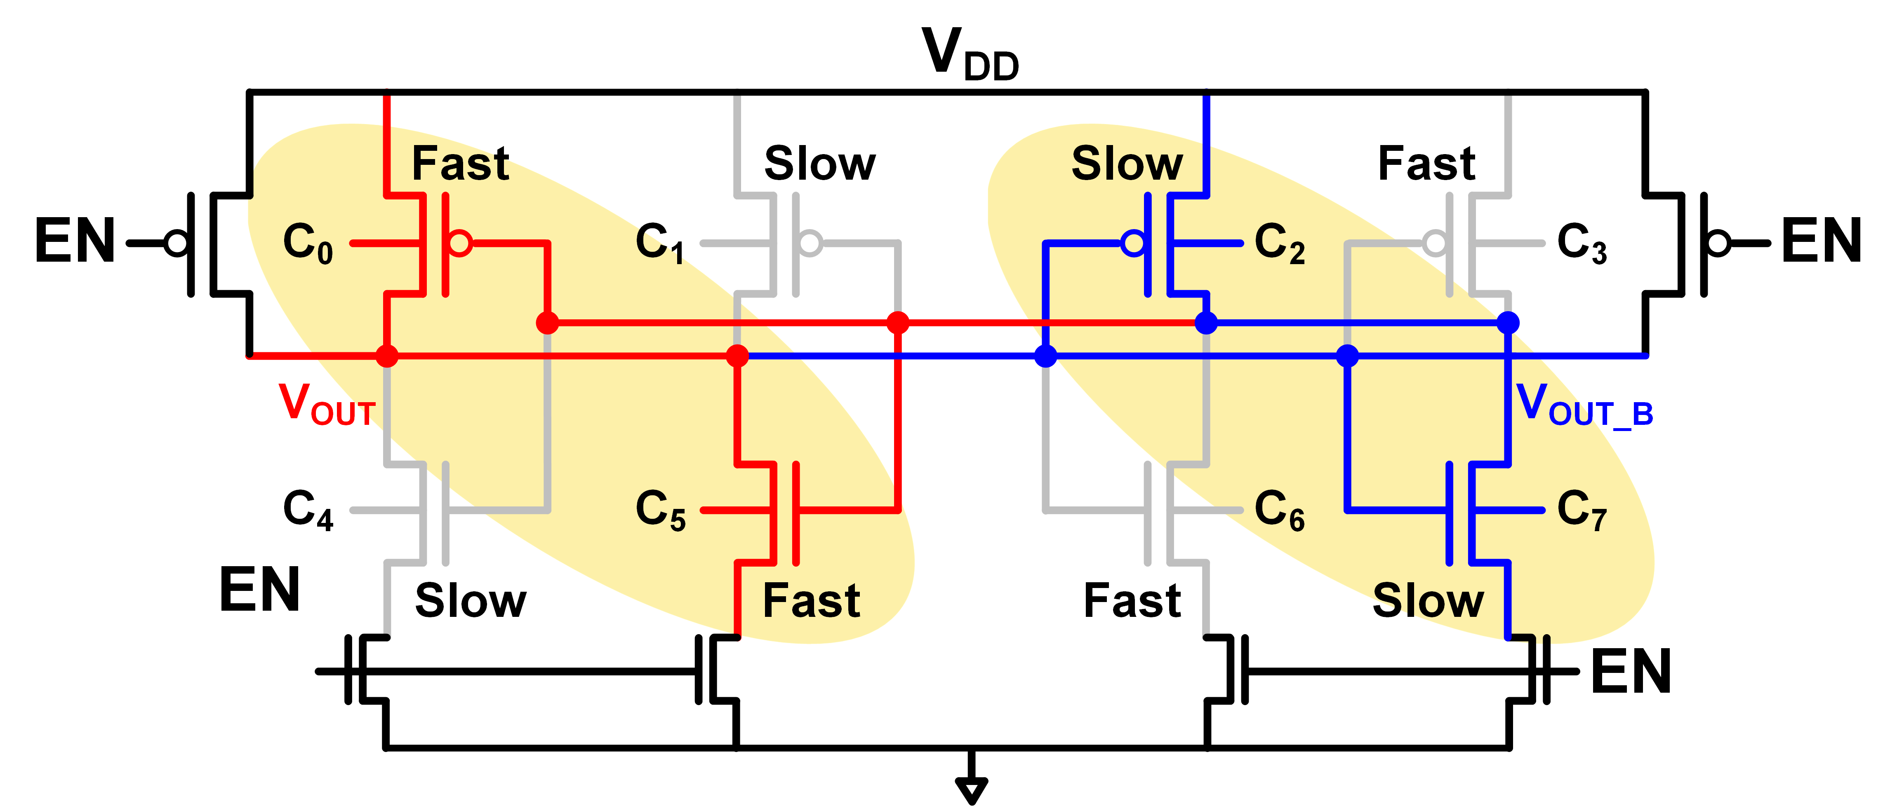
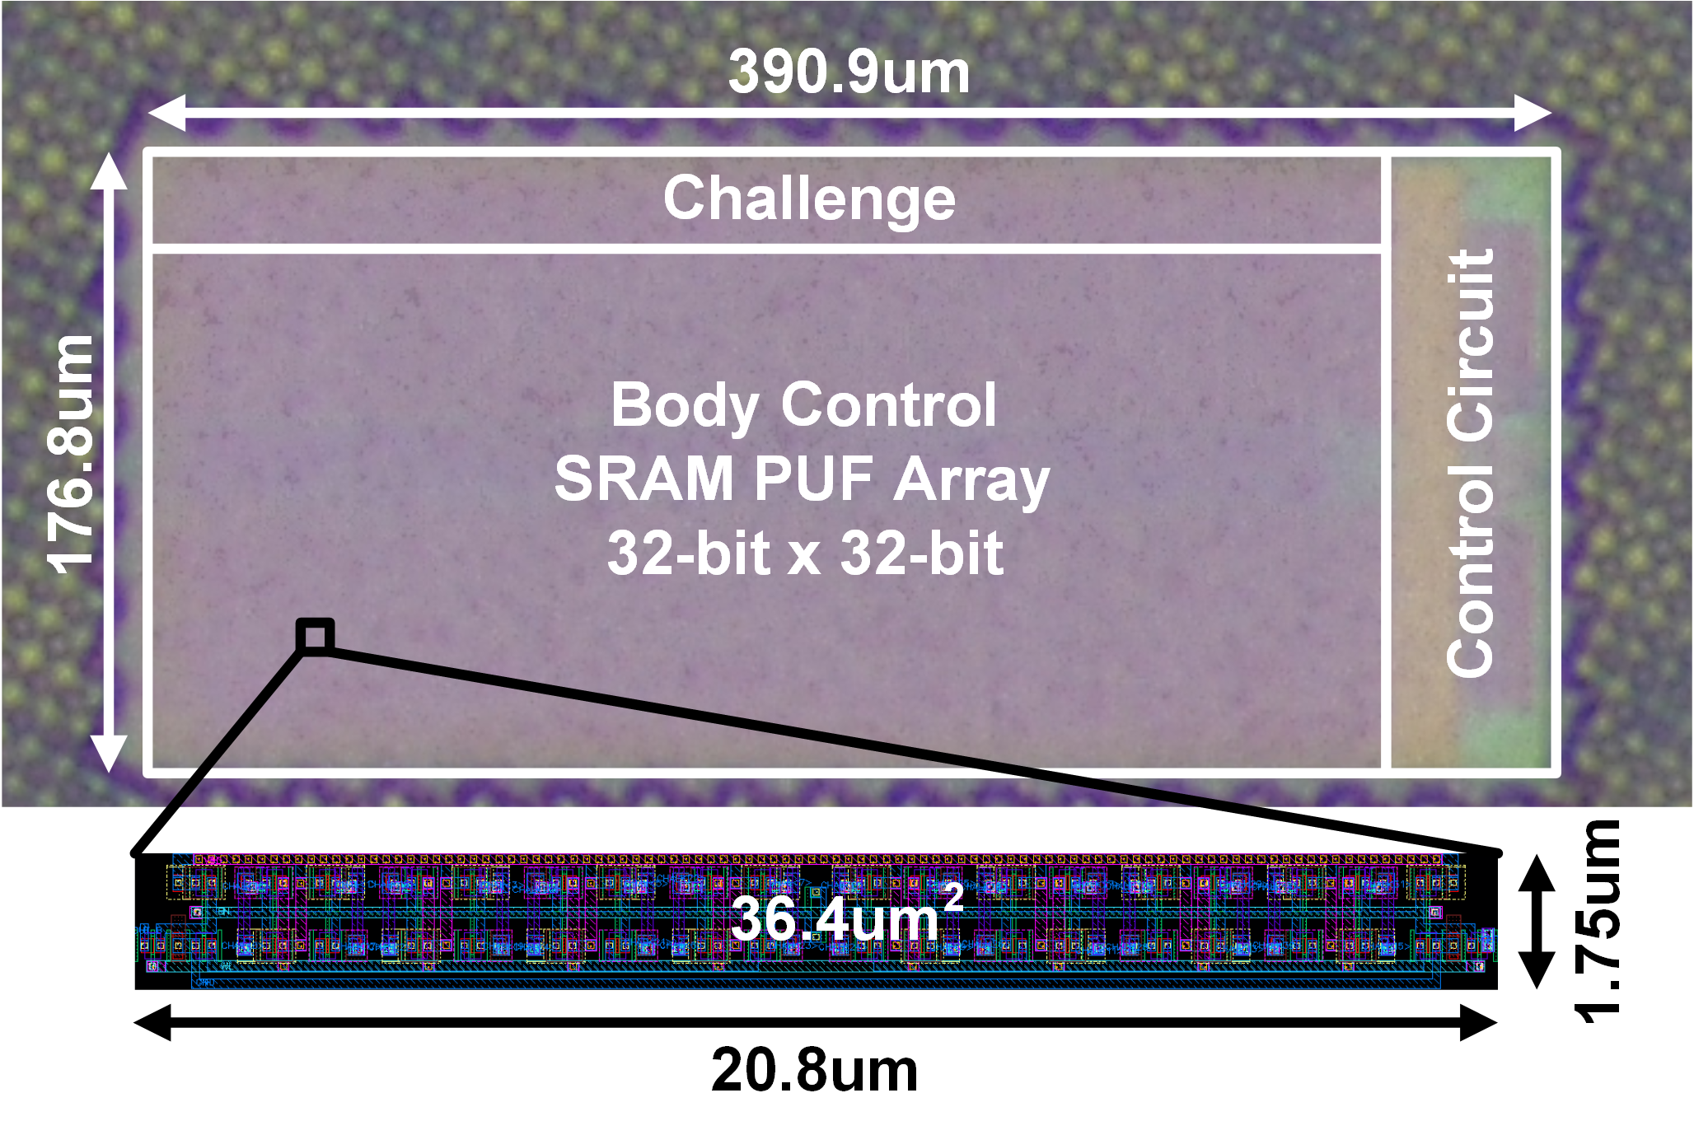
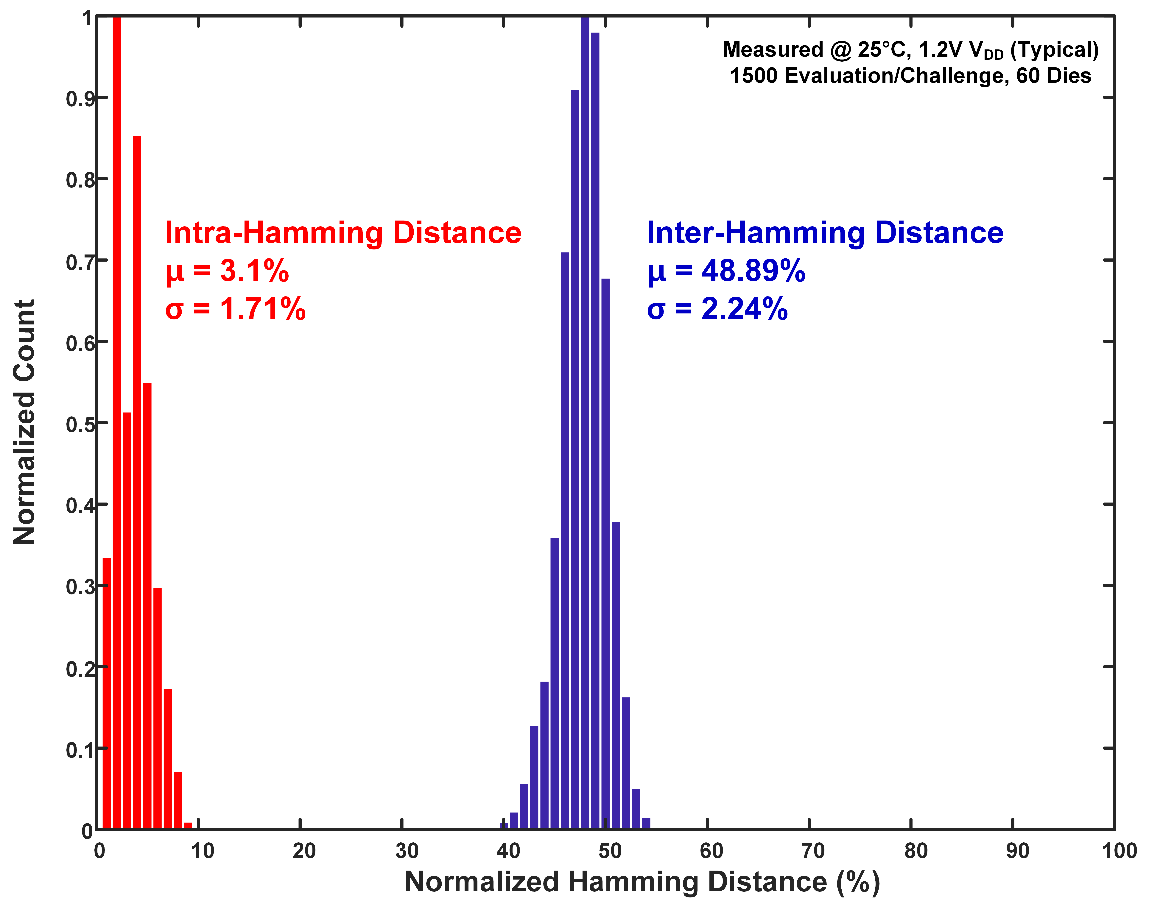
Compact SRAM-Based PUF Chip Employing
Body Voltage Control Technique
Chi Trung Ngo , Ju Hyeok Ahn and Jong-Phil Hong
School of Electrical Engineering, Chungbuk National University
Introduction
The conventional SRAM-based PUF uses a switching transistor and a main transistor to implement multiple CRPs → if CRPs ↑ → (area occupation + power consumption) ↑
To reduce the silicon area, the proposed structure adds the function of a switching transistor to a single main transistor, controlling the body voltage to switch the transistor
Fig. 1. SRAM-based PUF with multiple CRPs
Fig. 2. Conceptual structure of the conventional SRAM-based PUF
Fig. 3. CMOS Process corners
SRAM-Based PUF Employing Body Voltage Control Circuit Design
Main transistor merge Switching transistor → a single transistor
Operating speed caused by process variation
Convention structrure: 10 transistors/PUF cell.
Proposed structure: 6 transistors/PUF cell.
→ 40% reduction
Fig. 4. Conceptual structure of the proposed SRAM-based PUF
Fig. 5. Schematic structure of the proposed SRAM-based PUF
Fig. 6. Example of proposed structure operation with the cases of ‘‘Fast/Fast’’ and ‘‘Slow/Slow’’ vesus ‘‘Fast/Slow’’ and ‘‘Slow/Slow’’ transistors
Implement Result and Performance Comparison
Table I. Performance summary and comparison with prior works.
 | This work | IEEE VLSI Circuits ‘17 Jeloka el at. | IEEE ISSCC’15 Yang el at. | IEEE-JSSC’11 Stanzione el at.
CMOS Technology | 28nm | 28nm | 40nm | 90nm
PUF type | Bi-stable | Bi-stable | Digital | Analog
Bit-width of Challenge | 32 | 256 | 96 | 256
Bit-with of Response | 1024 | 64 | 1 | 31
Operating Condition (V) | 1.08-1.32 | 0.5-0.9 | 0.7-1.2 | 0.64-0.66
Inter-HD | 0.4889 | 0.483 | 0.5007 | -
Intra-HD | 0.0311 | 0.0317 | 0 | 0.1
Core Area (F²/bit) | 8,615 | 22,720 | 528,125 | 139,382
Energy Efficiency (pJ/bit) | 0.09 | 0.097 | 17.75 | 6080
No. of CRPs | 1.6E8 | 1.17E11 | 1E25 | 4.01E15
Fig. 7. Chip micrograph
Fig. 8. Measured inter/intra-PUF hamming distance distribution
Up to 1.6x10⁸ CRPs/die with 32b input, 1024b output
Controll the body voltage to reduce the number of transistor/PUF cell
→ Reduce 40% the number of transistors/PUF cell & active area/bit reaches 38% reduction
High Efficiency 90fJ/bit & Competitive Inter-HD value of 0.4889
Acknowledgements
This work was supported by the National Research Foundation of Korea(NRF) grant funded by the Korea government(MSIT) (No. NRF-2021R1A2C2005258).
The chip fabrication and EDA tool were supported by the IC Design Education Center(IDEC), Korea.

